Slide 1
Flight Fare prediction
Vaibhavi Thakkar
(100833169)

Slide 2
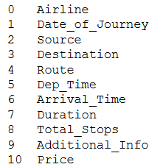
business problem to solve
Flight Fare Prediction
As with increase in corona pandemic flight prices have gone uncountable high.
Collected the flight details via searching through different website.
The collected result used to perform different operation and predict the future price output based on given input.
Shown are the column details used for flight fare price
analysis.

Slide 3
Technology Stack
IDE
Jupyter
Language used
Python
AI-Algorithm with highest accuracy
Random Forest Regressor
Model Error Evaluation
mean_absolute_error,mean_squared_error,r2_score

Slide 4
challenges during project execution
Firstly, the selection of definition for final project was greatest challenge.
Gathering of required data for different flights from different website and enhancing the collected data based on requirements.
Selection of which algorithm to choose from the available than can predict the accurate fare price.
Analysis the flow and to remove the unnecessary columns was quite challenging

Slide 5
improvements for the future of the application
Currently the project works on defined data set but can be improvise to make it dynamic.
UI part can be implemented to help user to check for the future price for different flights.
Accuracy of the system can be improvised by considering different test scenarios.
Every booking site can add prediction part to help the customer to select the cheap flight from available options.

Slide 6
Thank you!

